Slide 1


New Members
Welcome to Ostomy NSW
Notes:
Welcome to our first ever new member meeting. Thank you for joining and we hope you will benefit from this afternoon’s session. I am Stephen Lardner, the manager of Ostomy NSW. Our other presenter today is Lee Gavegan, Stomal Therapy Nurse (often referred to as an STN) and Clinical Nurse Consultant. Lee is self-employed and works with Ostomy NSW each Tuesday as a service to our members. I will spend the first 15 minutes explaining a little about our/your association, Lee will present some very valuable information relating to your skin, and we should have around 10 to 15 minutes at the end for questions.

Slide 2
Who is Ostomy NSW Limited (ONL)?
We are one of 21 Associations in Australia authorised to distribute stoma supplies. Often referred to as “ONL”.
We are a company Limited By Guarantee – owned and operated for our members.
We are a registered charity with the Australian Charities Not-for-profit Commission (ACNC).
16 part-time or casual paid staff (10 FTE); 35 volunteers (3.5 FTE).
Governed by a volunteer Board of Directors.
6000 members – some have been with us for many years.
Notes:
To begin, I will explain who is Ostomy NSW and how you order your appliances and supplies from us.

Slide 3
New Member pack (6 pages)
Notes:
When you received your first order from us, there was a white envelope which contained relevant information for you as a new member…. There is a 6-page information pack providing details on how to order. I will review some of this information shortly. If you have mis-placed this document, we can send you another one.

Slide 4
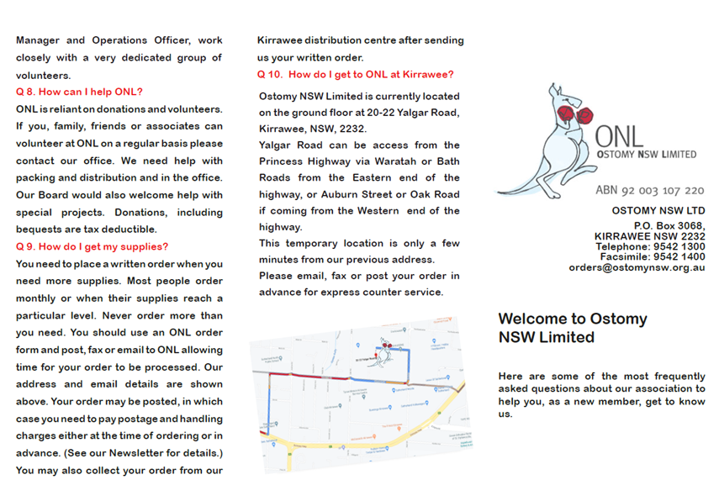
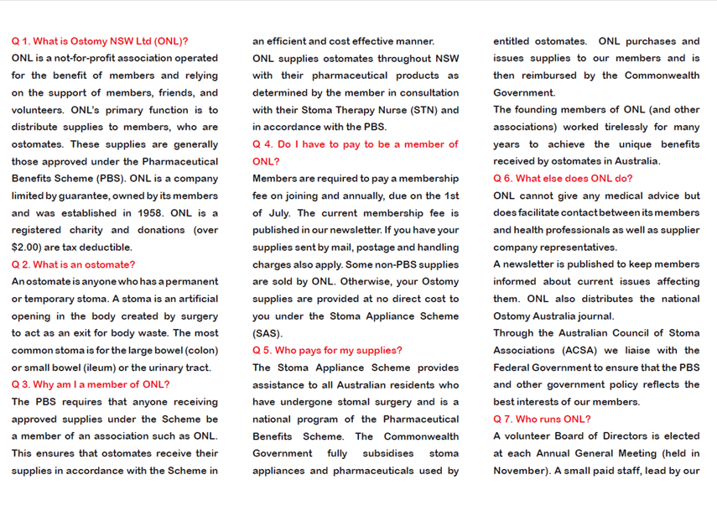
New Member brochure (2 pages)
Notes:
You also received a small glossy 2-fold brochure which also provides information and advice. One key point to know is Ostomy NSW distributes your appliances and assists with your products. We do not offer any clinical advice as we are not clinically trained. Hencve We have Lee joining us on the call today.

Slide 5
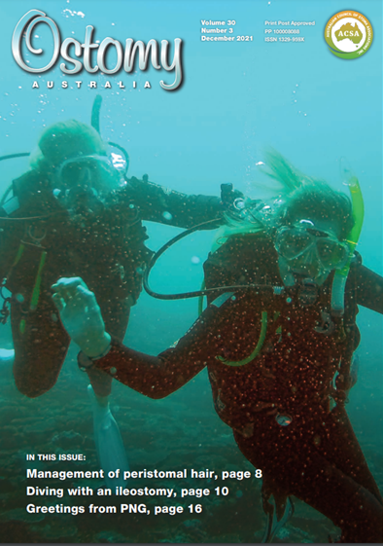

Magazines (when available)
Notes:
There are two multi-paged magazines that are published during the year. The smaller A5 brochure is unique to Ostomy NSW and compiled by me and some of our team. We publish this 4 times per year (one per season). The larger magazine is published nationally and distributed to all ostomates in Australia (around 50,000 people). This comes out three times per year. Both magazines are added to your supply parcel when you order and when they are available.

Slide 6
How do I order?
Orders must be in writing: ensures accuracy, provides an audit trail for Medicare.
There are a variety of methods:
  Online: https://www.ostomynsw.org.au/order_form18.php
  Email: orders@ostomynsw.org.au
  Fax: 02 9542 1400
  In writing to Ostomy NSW Limited, PO Box 3068, Kirrawee, NSW, 2232
There are 3,915 items on the Stoma Appliance Schedule – your code numbers are very important.
  eg. 10165 and 10365 are different products (closed and drainable)
  eg. XMHCCM532 and XMHCDM532 are different products.
  Our team uses the code you provide us, not the description. 29730 “25 mm please” may give you the wrong item.
Notes:
The next few slides explain how do you order, what do I receive with my supplies and how much does is cost? Firstly, How Do I order?

Slide 7
How do I order?
Provide your membership number, name and delivery address with your order. We will check our records and update if there are differences.
You may specify a different or temporary address for an order.
Medicare number – we claim on your behalf.
Notes:
Your membership number and Medicare number must be provided with your order. Without this information we cannot claim the cost on your behalf and we will have to either charge you for supplies, or hold supplies until we receive the information we require. We will contact you if information is missing (assuming we can identify who you are).

Slide 8

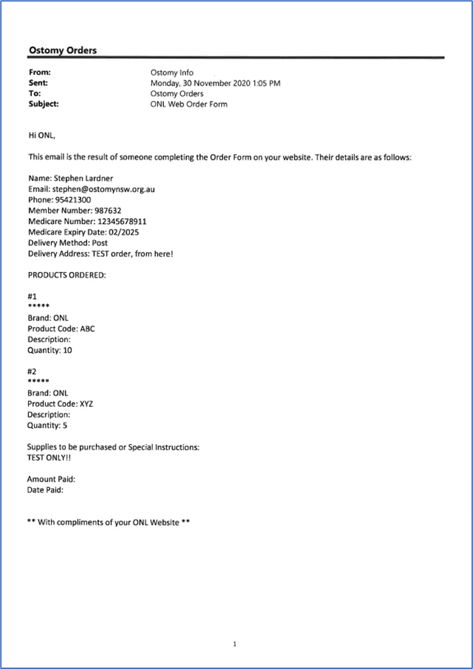
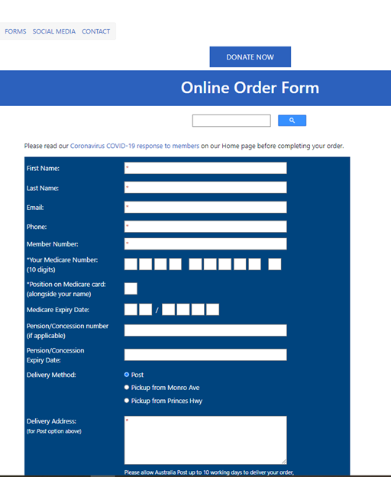
Online ordering is preferred
Notes:
Our online order form is the preferred method to receive your orders. This process marks as compulsory the fields we require to make sure your order is processed quickly and accurately. There are links to our payment site, which is secure and protected through a payment gateway process we use.

Slide 9
What is the cost?
Annual membership fees: currently $70 full member and $60 concession member.
Your membership fee provides around 30% of our running costs.
Postage $15 in NSW, $20 interstate, $22 Express. This offsets our postage costs from Australia Post eParcel.
That’s all!!
Ostomy NSW does not keep debit or credit card details on file – you will need to quote these each time you make a payment.
We process your Medicare rebate and Dept of Health pays a 2.75% commission to ONL- only 30% of our running costs.
Donations are important and greatly appreciated - $2 and above are tax deductible.
Notes:
The important “Money” question!
The average order value per year per member is $2,200. Even if you place small or infrequent orders, being a member is much cheaper than paying for appliances.

Slide 10
Your Information and Privacy
Email address and phone numbers – please keep us up to date with any changes.
We use email to contact you and for eParcel tracking.
Our computer system SAMS is secure.
We never send your personal information outside of ONL, without your permission (for instance, you may ask us to supply your details to a supplier).
Large email communications are sent as “blind copy” or through secure third parties.
Notes:
Privacy is important to every one of us. We do require information from you to process your orders – as I mentioned earlier. The parcels we send do not have any reference to Ostomy NSW, brand names nor medical supplies.

Slide 11
Packing Slip
Notes:
The last point I wanted to raise is our packing slip. With each order you receive, you will have in your parcel a packing slip.

Slide 12
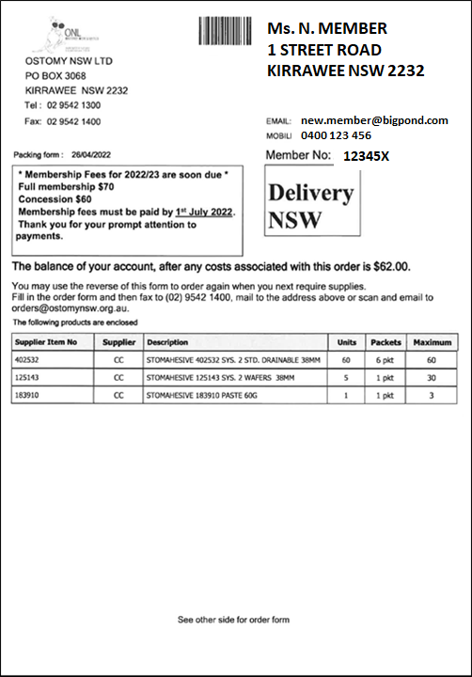
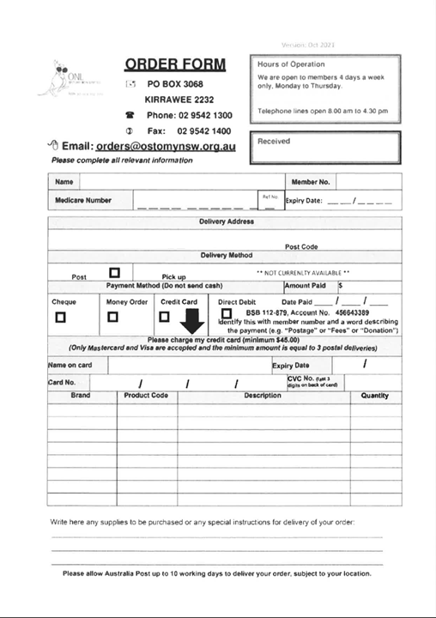
Front
Back
Notes:
One side shows your individual details, such as name, address, email and mobile phone number. A window at the top contains current messages (eg. Fees). It shows you the amount of your money we are holding in your account, or if it is negative, the amount you owe to Ostomy NSW for postage. The appliances and pharmaceuticals you ordered are listed, the quantity supplied (units and boxes) and the maximum monthly allowance for these appliances.
The reverse side is a blank order form you can use to place your next order – or you can send to us the front and a message, such as “my June order..”.
I will take any questions at the end of the session, or simply send an email to me: manager@ostomynsw.org.au.

Slide 13

Introducing Lee Gavegan CNC STN

Slide 14
disclaimer
OSTOMY NSW LIMItEd supports all companies equally SUPPLYING STOMA & RELATED PRODUCTS.
This presentation is for education only and does not replace discussing / seeing your stomal therapist with any issues you may be concerned about.

